Slide 1
Customer Churn Prediction using Machine Learning
Group – 17
Jaswanth Sirigiri (A04332429)
Koushik Reddy Kambham (A04316083)
Raghuvamsi Mallampalli (A04316093)
Naresh Vemula (A04332886)

Slide 2

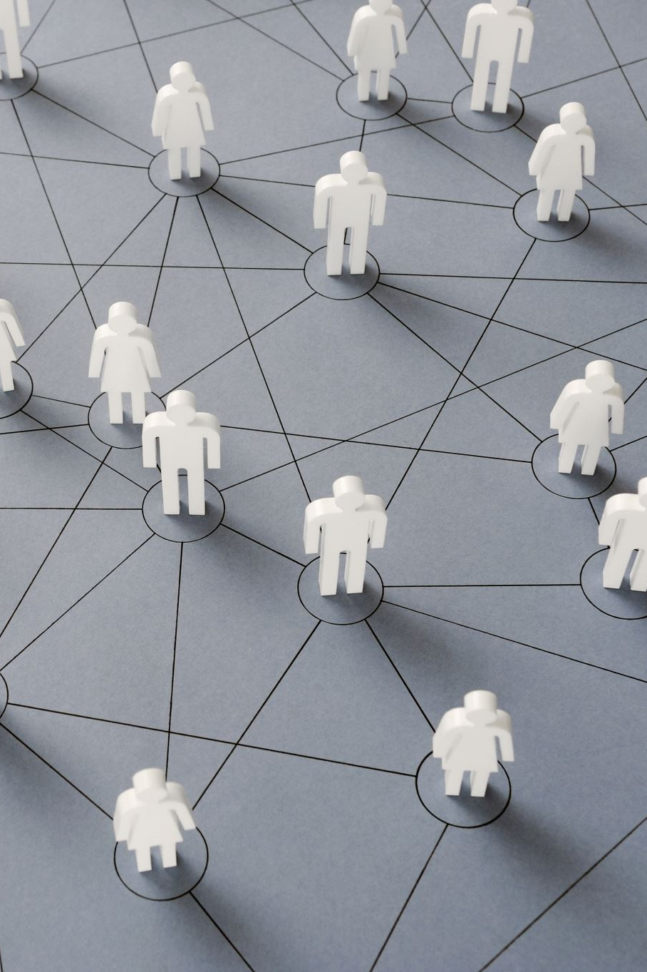
PROBLEM STATEMENT AND MOTIVATION
In the telecom sector, a huge volume of data is being generated daily. Decision-makers emphasized that attaining new customers is costlier than retaining the existing ones.
This proposes a churn prediction model that uses classification and clustering techniques to identify the churn customers and provides the factors behind the churning of customers in the telecom sector.
The proposed churn prediction model is evaluated using metrics, such as accuracy, precision, and recall.
By knowing the significant churn factors from customers' data, Customer Relationship Management(CRM)can improve productivity, recommend relevant promotions to the group of likely churn customers based on similar behavior patterns, and excessively improve marketing campaigns of the company.

Slide 3
Introduction
Customer churn is broadly classified into two categories: accidental and intentional, with accidental churn occurring due to external factors like financial constraints and intentional churn arising from customers switching to competitors offering better services or prices.
The project focuses on investigating the primary causes of customer churn using Telecom customer data.
Data collection and processing were conducted to prepare the dataset for analysis.
Four prominent machine learning algorithms Random Forest (RF), Support Vector Machine (SVM), Decision Tree (DT), and k-nearest Neighbors (KNN) were implemented and compared using the processed data.
The objective is to identify the most effective algorithm for predicting and understanding customer churn patterns, ultimately aiding in retention strategies and business decision-making.

Slide 4

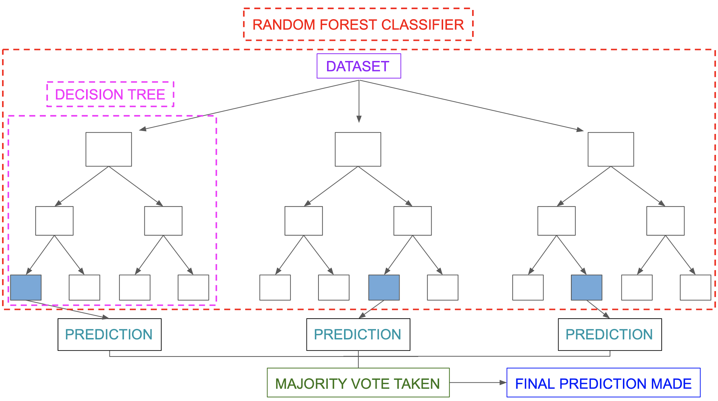
Methodology and Approach
Support Vector Machine (SVM):
Support Vector Machine or SVM is one of the most popular Supervised Learning algorithms.
The goal of the SVM algorithm is to create the best line or decision boundary that can segregate n-dimensional space into classes so that we can easily put the new data point in the correct category in the future.
Random Forest Classifier (RF):
Random Forest can be used for both Classification and Regression problems in ML. It is based on the concept of ensemble learning.
Random Forest is a classifier that contains several decision trees on various subsets of the given dataset and takes the average to improve the predictive accuracy of that dataset

Slide 5
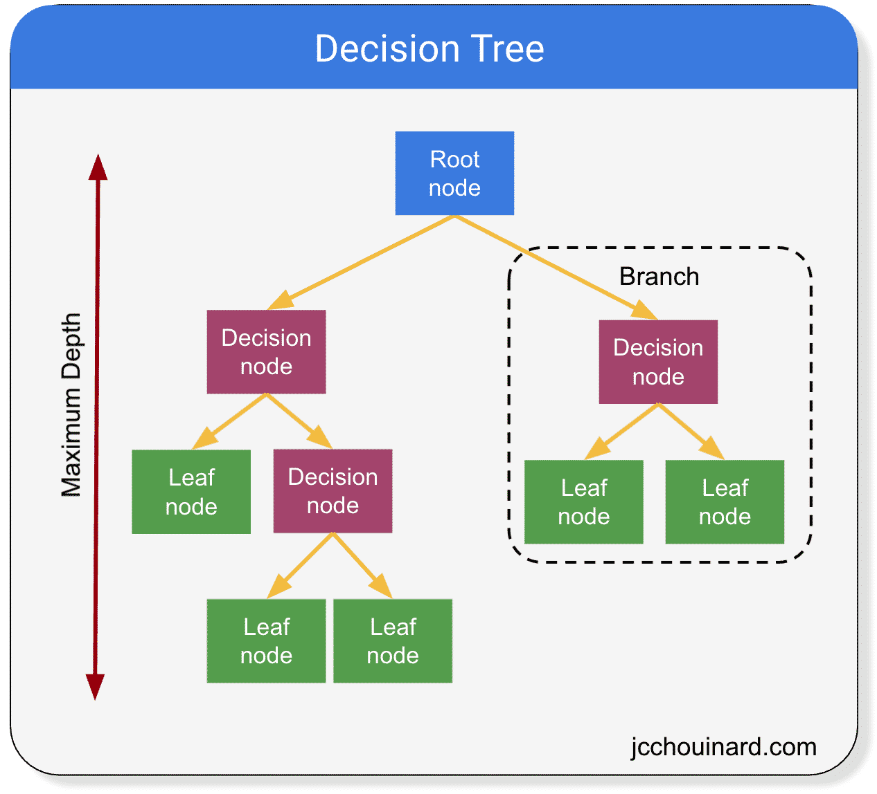
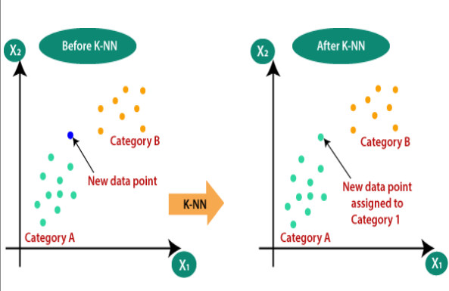
Decision Tree Classifier (DT):
A Decision tree is a flowchart-like tree structure, where each internal node denotes a test on an attribute, each branch represents an outcome of the test, and each leaf node (terminal node) holds a class label.
It is a graphical representation for getting all the possible solutions to a problem/decision based on given conditions.
K-Nearest Neighbor (KNN):
K-Nearest Neighbor is one of the simplest Machine Learning algorithms based on Supervised Learning technique.
K-NN algorithm stores all the available data and classifies a new data point based on the similarity. This means when new data appears then it can be easily classified into a well suite category.

Slide 6
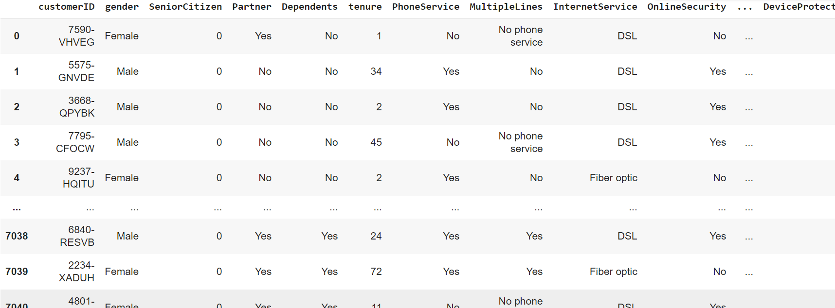
Dataset
We have collected the data from the Kaggle website- “TELECOM CHURN DATASET (IBM WATSON ANALYTICS)”.
There are in total 7043 records with 21 features and the data set includes the following information

Slide 7
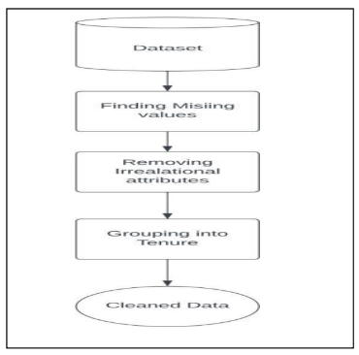
Data preprocessing

Slide 8
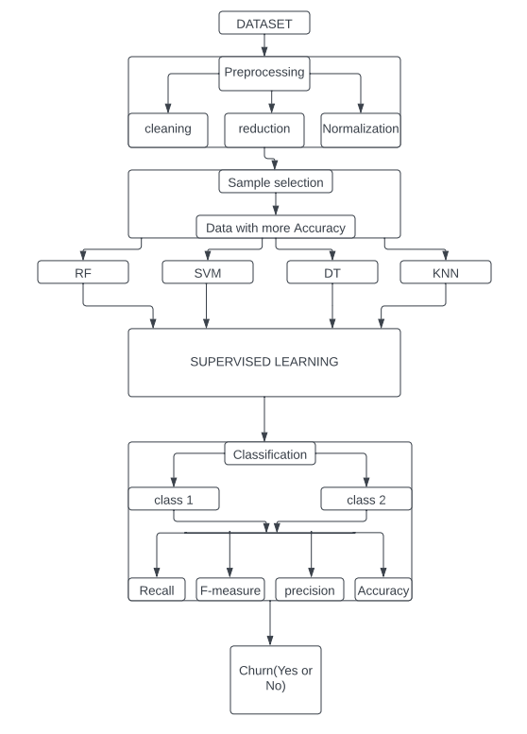
Model Architecture and Implementation

Slide 9
Libraries Used
NumPy
Pandas
Scikit-learn
Matplotlib
Seaborn
Plotly Express

Slide 10
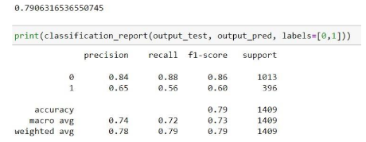
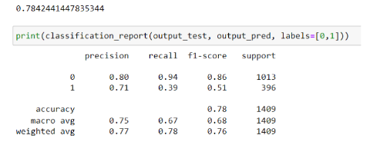
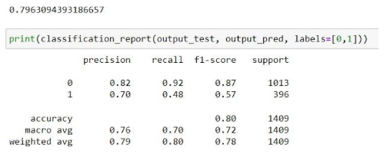
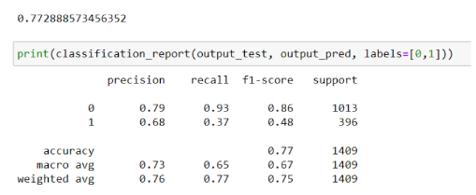
Evaluation Metrics and Results
Before SMOTE-ENN:
Decision Tree
Random Forest
Support Vector Machine
K-Nearest Neighbours

Slide 11
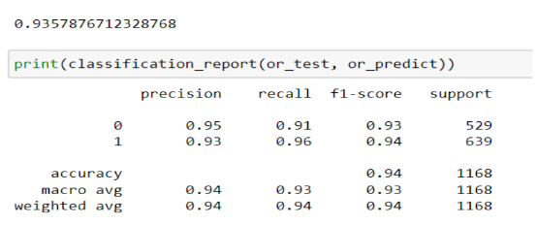
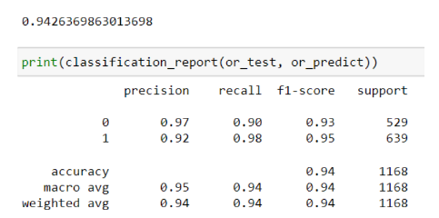
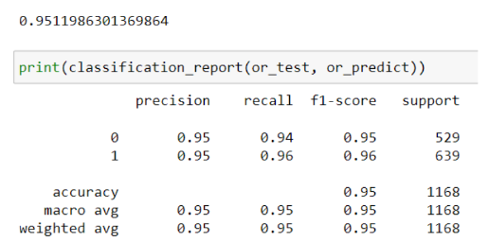
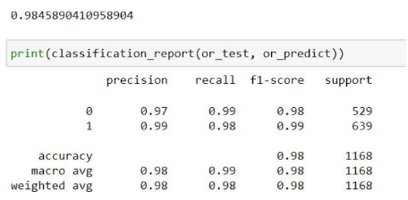
After SMOTE-ENN
Decision Tree
Random Forest
Support Vector Machine
K-Nearest Neighbours

Slide 12
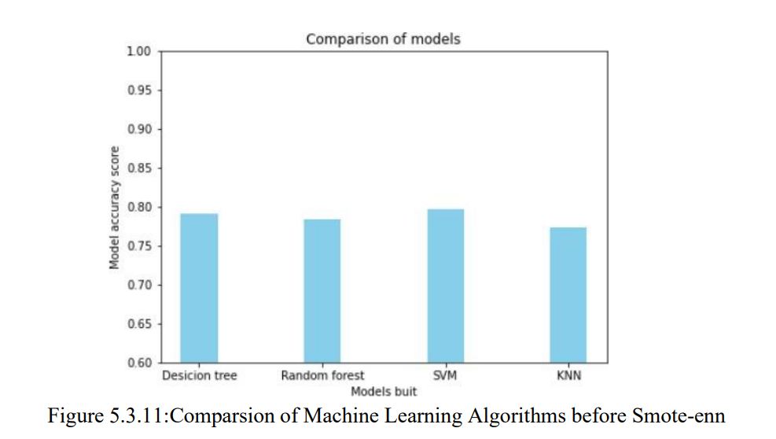
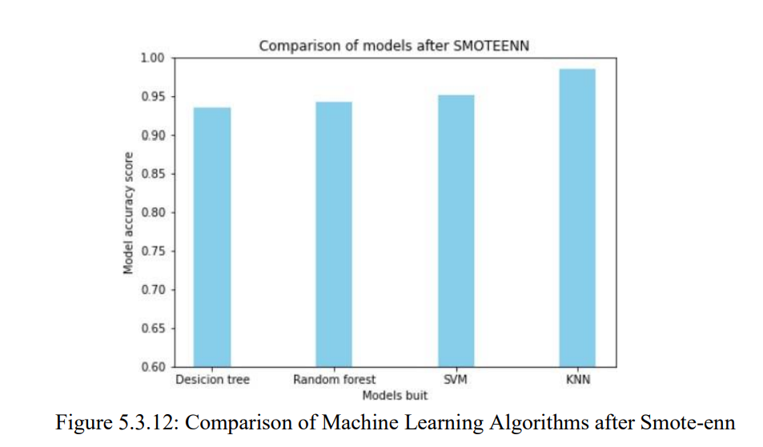
Performance and Efficiency

Slide 13
Challenges and Limitations
Imbalanced Data: The project addresses the challenge of imbalanced data in the telecommunications industry, where the number of customers leaving the company is relatively small compared to the total customer base.
Model Performance: The performance of machine learning algorithms such as Random Forest Classifier, Support Vector Machine, Decision Tree, and K-Nearest Neighbors to predict customer churn can vary based on the specific characteristics of the dataset.
Deployment and Monitoring: Once a suitable mdel is developed, deploying it into production and monitoring its performance in real time can present technical and operational challenges. Integration with existing software and ensuring the model's continued accuracy are important considerations.

Slide 14
Overall Impression
The predictions from the ML model can help in understanding the customers who might leave and their service. With this information, the company can do the following:
Relationship Managers (RM) get a daily feed on who has the propensity to churn and what are the influencing factors.
This can help trigger a conversation with the customer and understand their pain points and possibly fix the situation even before the churn occurs.
This can create more customer entanglement as the RM would reach out to them anticipating issues that will eventually increase their lifetime value.

Slide 15
References
Kaggle: https://www.kaggle.com/datasets/zagarsuren/telecom-churn-dataset-ibm-watson-analytics/data
S. Stehani, N. Karunya, Dr. J.B.Ranjan, Sagara Sumathipala, T.C. Sandanayake, “Customer Churn Reasoning in Telecommunication Domain”, March 2020.
Hennig‐Thurau, Thorsten, and Alexander Klee. “The Impact of Customer Satisfaction and Relationship Quality on Customer Retention: A Critical Reassessment and Model Development.” Psychology & Marketing 14, no. 8 (December 1, 1997): 737–64.

Slide 16
Q & A

Slide 17
Thank You.

